Slide 1
REAL INTEGRATED IDE
- Visual Studio Team System
Agilent VEE Team - JIA Dong

Slide 2
Agenda
Overview
Concepts
Code Analysis
Refactor
Team Foundation Power Tools
Miscellaneous

Slide 3
Overview - Situation
Used several tools and applications to drive SDLC process.
Visual Studio
Bug tracker
Spider
Clear quest
Build
Cruise.NET
Shell Script
Test
Unit test
Functional test
Development
Notes:
Describe the process of resolve a defect to show the lack of integration.

Slide 4
Overview - Traditional IDE
Includes: | NOT includes:
Source code editor | Bug tracker
Compiler/interpreter | Test system
Build automation | Production build system
Debugger | Process management
 | Document management
 | Reports
 | Web portal
VSTS integrates them ALL!

Slide 5
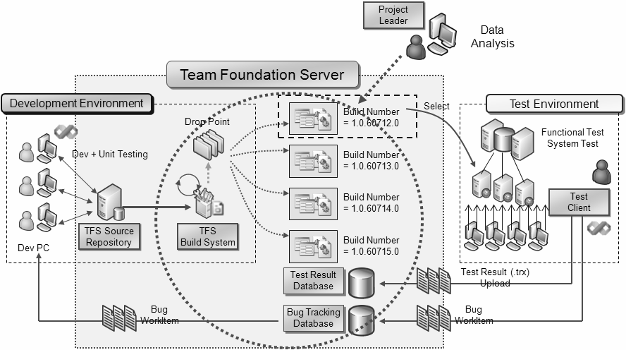
Overview - Use case

Slide 6
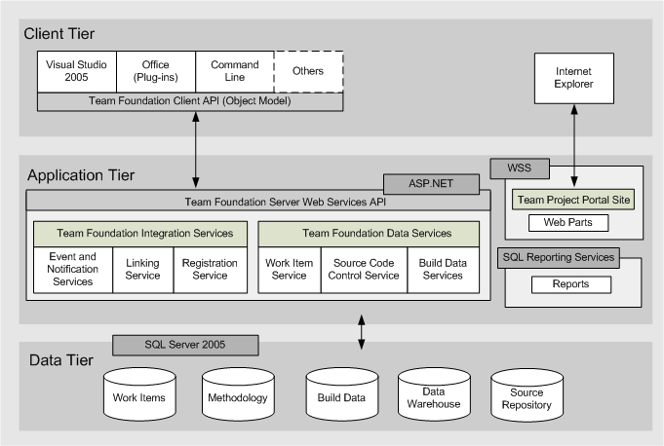
Overview - Architecture
Visual Studio Team System
Team Foundation Server

Slide 7
Concepts
Team project
Workspace
Work item
Changeset
Shelve
Check-in policy
Branch

Slide 8
Concepts - Team project
The named collection to hold everything in SDLC.
A management unit
Security
Group membership
Source Control

Slide 9
Concepts - Team project
Groups together
Work Items
Documents
Reports
Builds
Source control
Area and Iteration
Project portal
Project alert

Slide 10
Concepts - Workspace
Represents a client-side copy of the files in the server that you want to work in.
Per computer, per user account
Active or Cloaked

Slide 11
Concepts - Work item
A record to track the assignment and state of work.
A relationship between task and people
types: task, change request, risk, review, requirement, and bug.
Can be customized
Notes:
Show TODO list without work item;
Show create a work item form a compile warning;
Explain the linkage concepte;

Slide 12
Concepts - Work item
Core of team system
Work item
Changeset
Test result
Compile warning
Versioned Item
Build failusre
Notes:
Show TODO list without work item;
Show create a work item form a compile warning;
Explain the linkage concepte;

Slide 13
Concepts - Changeset
A logical grouping of changes.
Convenient unit for change management
A changeset number is a repository wide number

Slide 14


















File Store
foo.cs
bar.vb
Commit
9
11
Upload
Handler
12
15
“The Deltafier”
17
17
Download
Handler
Get foo.cs;12
9
12
15
12
File Cache
Compression + Delta Storage ≈ 70% Space Savings!

Slide 15
Concepts - Shelve
Set aside pending changes without checkin.
Scenarios
Switch task, Backup, Share code, Code review

Slide 16
Concepts - Check-in Policy
Ensure the quality of check-ins by some pre-defined rules.
Pre-defined check-in policy
Builds, Comments, Code Analysis, testing…
Can be customized
Notes:
Use fenglu12’ shelve set to present
Show “tf diff” at the same time

Slide 17
Concepts - Branch
A collection of files to evolve in two or more divergent paths
Maintain more similar code bases
Recommend putting all branches under $/<project>/Branches
Build scripts should be tolerant of differing root locations

Slide 18
Concepts - Branch
Forward Integration
Integrating changes from parent to child
Reverse Integration
Integrating changes from child to parent
Branch1
Change4
Change6
Truck
Change1
Change2
Branch2
Change3
Change5
Change7
FI
FI
RI
RI

Slide 19
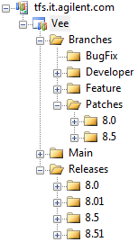
Concepts - Branch
Branch per Developer
Branch per Feature

Slide 20
Code Analysis
Static code analysis
FxCop
PREfast
Code Metrics
Dynamic code analysis
Profiler

Slide 21
Code Analysis - FxCop
Microsoft use it to improve their code quality
Be used in check-in policy
Be used in build process
What rules do Microsoft have turned on internally?
Framework Design Guidelines

Slide 22
Code Analysis - PREfast
Static code analysis for C/C++
A command line option for cl
cl /analyze foo.c
Cross managed and native world
Support Annotation

Slide 23
Code Analysis - Code Metrics
Good code? Bad code? How to score the quality of code?
Maintainability Index
Cyclomatic Complexity
Depth of Inheritance
Class Coupling
Lines of Code

Slide 24
Code Analysis - Code Metrics
Integrated with FxCop
Maintainability rules
Metric | Threshold
Depth of Inheritance | Warning at above 5 levels deep
Complexity | Warning at above 25
Maintainability Index | Warning at below 20
Class Coupling | Warning at above 80 for class and above 30 for a method

Slide 25
Code Analysis - Profiler
Dynamic code analysis tool
Help developer to improve performance
Analysis managed and native code both
Two methods of profiling
Sample
Instrumentation
Generate well-formatted reports

Slide 26
Refactor
Improve the quality of code continually
adhering to OO-best practices
increasing type safety
improving performance
increasing code readability and maintainability…
Refactor it!
Refactoring: Improve the design of existing code

Slide 27
Team Foundation Sever Power Tools
Command-line tool
Annotate
Rollback
Treeclean
Uu
Custom check-in policy pack
Build notification
More information

Slide 28
Miscellaneous
PowerCommands
Debug .NET framework source code
Turn OFF the "Enable Just My Code"
Turn ON the "Enable Source Server Support“
Set the symbol file location to be: http://referencesource.microsoft.com/symbols

Slide 29
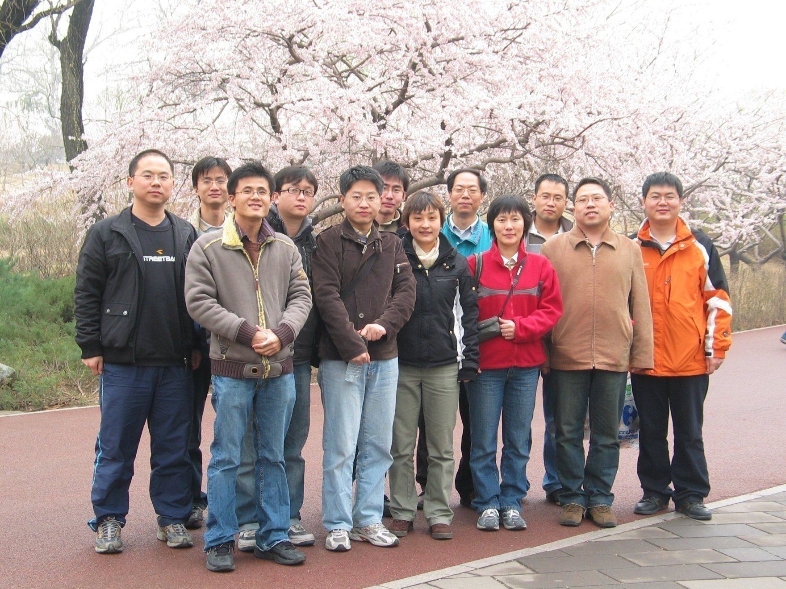

Thanks!

Slide 30
Q& A

